Slide 1
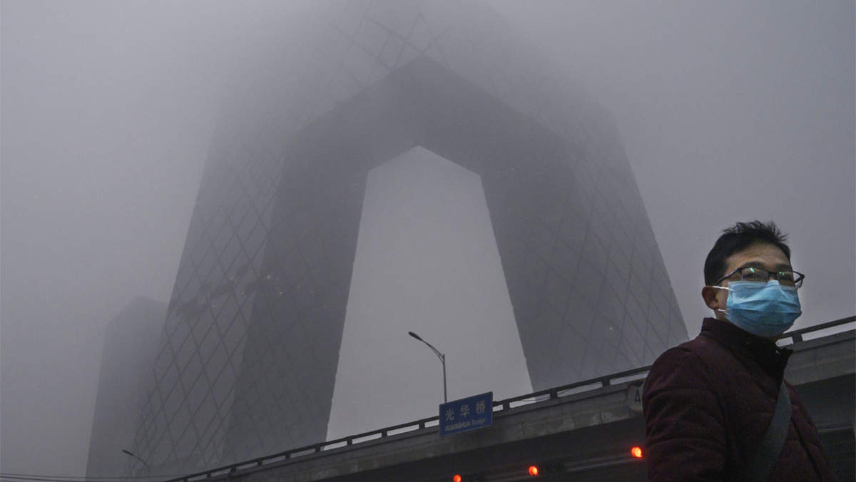
AQI in Beijing
MUSHROOM & CO
AUGUST 2023
INFO@MUSHROOM.COM

Slide 2

MUSHROOM & CO
Breathe easy
in Beijing today
and
anywhere in the world
tomorrow
AUGUST 2032
INFO@COMPANY.COM

Slide 3
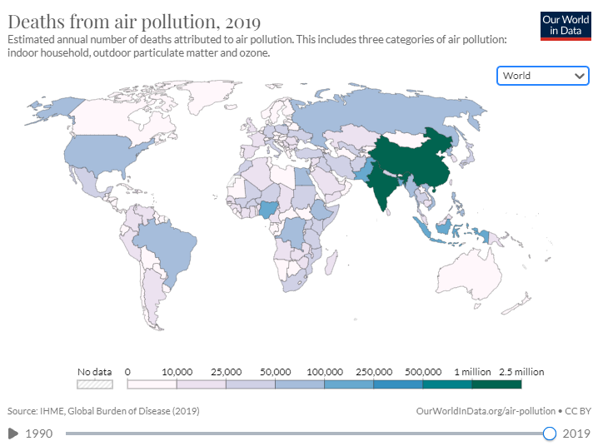
OUR MISSION
Air pollution is one of the world’s largest health and environmental problems.
Sadly China is heavily affected being one of the most polluted countries in the world.
AUGUST 2032
INFO@COMPANY.COM

Slide 4
OUR MISSION
We decided to use Beijing Multi-Site Air-Quality Data Set
https://www.kaggle.com/datasets/sid321axn/beijing-multisite-airquality-data-set?resource=download
to understand
Can we predict air quality based on available data?
How does weather affect air quality?
When and where is it best to indulge in outdoor sports in Beijing?
​
AUGUST 2032
INFO@COMPANY.COM

Slide 5
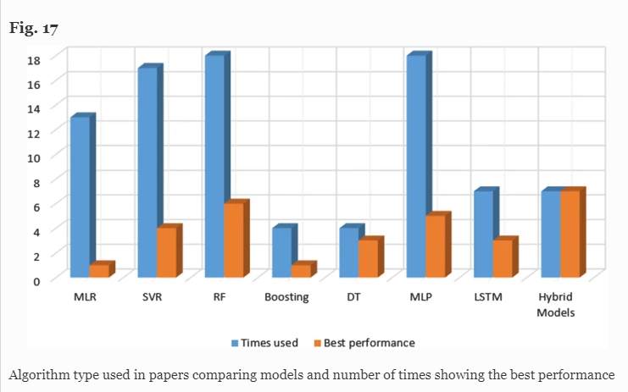
Point #1
Can we predict air quality based on available data?
We will use available data and utilize different machine learning models to predict the air pollution by the day and time of the day. We will be using one of the deep learning algorithms or hybrid of them, as they proved the most efficient based on this article.
Point #2
How does weather affect air quality?
Point #3
When and where is it best to indulge in outdoor sports in Beijing?
INFO@COMPANY.COM

Slide 6
Point #1
Can we predict air quality based on available data?
Point #2
How does weather affect air quality?
We will combine weather and pollution forecasts. Then review how they are associated with each other, show graphs.
We will evaluate importance of the the variables and continue with random forest model, as it has been proved to be the best in this article.
Point #3
When and where is it best to indulge in outdoor sports in Beijing?
INFO@COMPANY.COM

Slide 7
Point #1
Can we predict air quality based on available data?
Point #2
How does weather affect air quality?
Point #3
When and where is it best to indulge in outdoor sports in Beijing?
We will use available data and locations of the meteorological stations in Beijing to predict air pollution index for specific location based on the areas around the 12 stations we have data for. Naive Bayes or Random Forest
INFO@COMPANY.COM

Slide 8
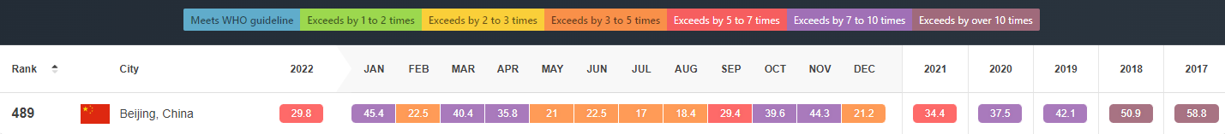
OUR MISSION
In 1998 Beijing declared war on air pollution. The challenge was to find ways to improve air quality in one of the largest and fastest growing cities in the developing world. 20 years on and it appears that Beijing is winning the battle. Air quality has improved substantially, and the lessons learned provide a roadmap for other cities tackling air pollution.
AUGUST 2032
INFO@COMPANY.COM

Slide 9
OUR MISSION
In 2013 Beijing adopted more systematic and intensive measures for air pollution control. By the end of 2017 fine particulate pollution (PM2.5) fell by 35% and by 25% in the surrounding Beijing-Tianjin-Hebei region. Much of this reduction came from measures to control coal-fired boilers, provide cleaner domestic fuels, and industrial restructuring.
Based on the data we have for 2013 - 2017 we plan to see if our model predicts similar results.
AUGUST 2032
INFO@COMPANY.COM

